Slide 1
Lecture 2
August 29 2023

Slide 2
Where we’re going over the coming weeks
This week and next we’re going to get up to speed with python and jupyter notebook tools
We’ll do a lot of group work to (hopefully!) keep things lively
We’ll work in a few environmental data sets
In Week 4, we’ll start talking about our term project.
From Week 5 on, we’ll be talking about prediction modeling methods.

Slide 3
Reading for next time
Blei and Smyth. A question to focus your reading:
The paper discusses statistical, computational, and human perspectives on data science.
Identify one topic in each of these categories that is “new” relative to how people worked with data 50 years ago.

Slide 4
Ed Discussion
We’ll set up threads for each HW and Lab assignment
Course staff will answer clarifying questions, logistical questions, etc.
If you have conceptual questions, or help with coding, please come to office hours.
Office hours
Monthly coffee w Duncan: talk We’ll chat data, environment and society – but broader topics, not course nuts and bolts.
Sign up link on bCourses homepage
Weekly:
Colette: Tu 2-3, We 1-1:30, 5 Giannini
Duncan: Th 4-5, 337 Giannini

Slide 5
Finding lecture files
They’ll be on the course github site:
https://github.com/duncancallaway/ER131_2023/

Slide 6
What we’ll do today
Review some basic ideas about origins of data
(re)Introduce datahub.berkeley.edu and jupyter notebooks
Do a simple example: Working with renewable energy data on datahub

Slide 7
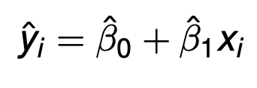
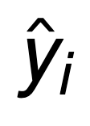
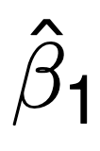
Recap – key concepts from last time
Prediction versus inference (y versus β)
is a prediction of a target variable
infers a relationship between two variables
Resource allocation decisions
Big data: what defines it?
Notes:
Big data: many fields, or features, per data point. I.e. the data are both numerous and WIDE

Slide 8
Let’s start with a small group exercise
What is a simple random sample?
Why do political polls give different answers than the final vote?
Are political polling numbers prediction, inference, or something else?
Notes:
SRS:
- subset of elements of a population
- each element is chosen purely randomly
Political polls:
In their simplest form, they infer average voting preferences.
But most polls (and especially organizations that build models with multiple polls, like 538) weight the outcomes of their results to better match actual historical voting patterns
In this way, weighted polls attempt to predict something that can’t be measured (how an entire population will actually vote) based on historical observations of how people actually voted AND current poll numbers.

Slide 9
Basics of Data Origins (and why we care)
Key concepts to cover
Sampling
Bias and variance
Prediction vs inference
Provenance

Slide 10
Defining some basic terms
Population
Every possible observation associated with the process of interest.
Income of every person in the United States
Temperature in every hour of time
Pollution in every city in the world
Sample
A subset of observations drawn from a population
Examples
Administrative databases
Convenience samples, self-selected samples
Random Samples
Census: Essentially, a sample that comprises the entire population
Notes:
Population:
All houses in zip 94609
all yellow houses in 94609
All yellow houses over 50 years old in 94609
Sample: a fraction of all yellow houses in Oakland zip code 94609.
- If the houses are yellow and over 50 years old, there are still OTHER houses in 94609 that are also yellow and over 50.

Slide 11
What might we do with a sample?
Make predictions
About the entire population
In space
In time
Make inferences
What is the effect of x on y?
Notes:
yhat = f(x)
vs
y = betahat x + epsilon

Slide 12
What is a simple random sample (SRS)?
A subset of elements of a population
Each element is chosen at random
With replacement:
after you choose an element, it goes back into the set of elements you’re randomly sampling from.
Without replacement:
after you choose an element, it does not go back into the set of elements you’re randomly sampling from.
Cluster random sampling and stratified random sampling are other kinds of random samples

Slide 13
What happens if we don’t have SRS?
All efforts to predict or infer something about a population are biased.
Elections: What fraction of respondents would vote for a presidential candidate for
Random sample of 400
Non-random sample of 60,000,000
Plot on the right shows the estimate from many different random samples of 400 versus the single “big” data set estimate
The small sample is often more wrong but on average it is correct.
Notes:
Taken from the DS100 textbook, http://www.textbook.ds100.org/ch/02/design_srs_vs_big_data.html

Slide 14
Is bias the only thing we should care about when we construct a sample?
No, we also care about sample size → this influences the variance of the thing you’re trying to estimate.
Variance:
The size of the range of possible estimates you’d get from each sample
Notes:
Figures taken from https://www.inferentialthinking.com/chapters/14/5/Variability_of_the_Sample_Mean
Data are flight delays for United flights. The code that generated the data sampled without replacement from 14000 fligths. The histogram shows the percentage of samples with a mean in a given range.

Slide 15
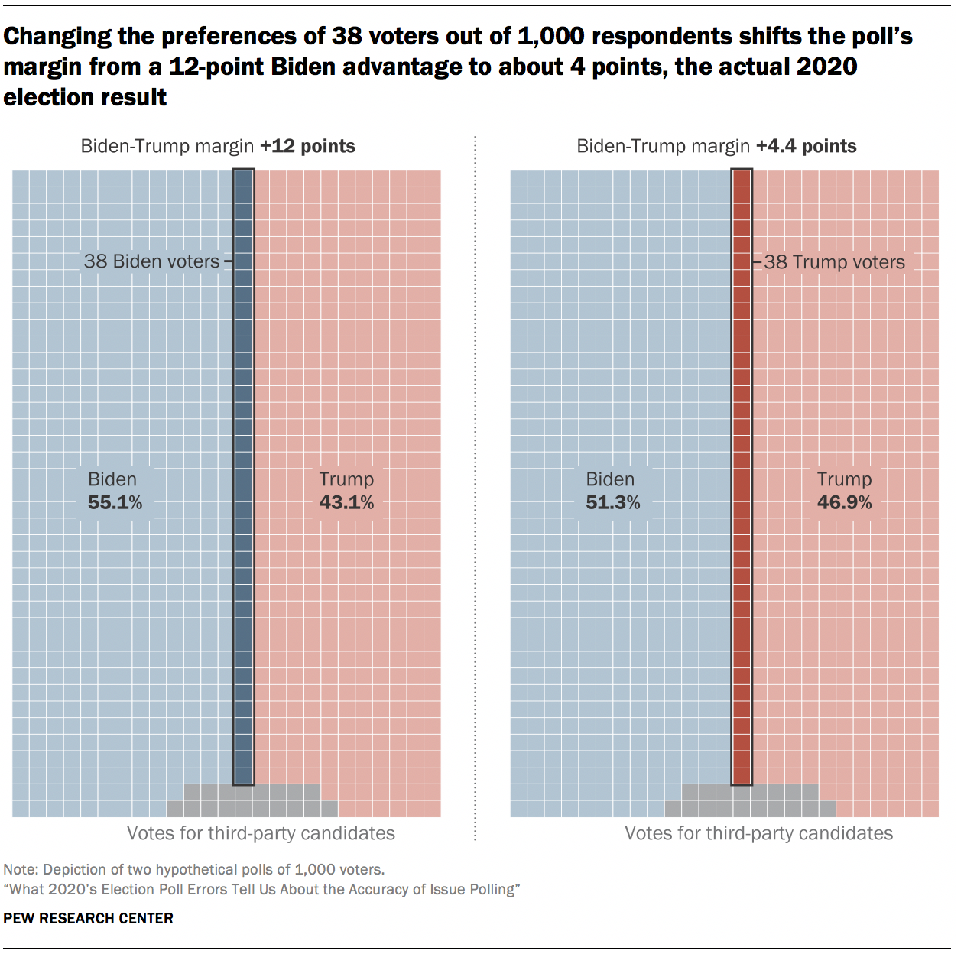
Why do voting polls give answers that are different from the final outcome?
Variance:
Small sample sizes leads to variance
Bias:
Sample bias. Polling firms didn’t sample the population of voters randomly.
Measurement error (untruthful responses) → Bias.
Variance and sample bias are controllable in the way we design the sample.
Measurement error is trickier, and depends on how we query the sample once it is created.

Slide 16
What is data provenance?
Provenance: The mechanisms by which the data arose
What mechanism generated the data
An experiment?
Observations in “nature”?
An industrial process?
How was it collected? A random sample, an administrative database?
How were the data manipulated (cleaned, transformed, etc) to get to their current condition?
Understanding provenance enables us to understand how well we can generalize.

Slide 17
Recap: Basics of Data Origins (and why we care)
Key concepts to cover
Sampling
Bias and variance
Prediction vs inference
Provenance

Slide 18
Next, let’s introduce datahub
datahub.berkeley.edu
(Navigate to the jupyter notebooks in the lecture02 folder on datahub in case you missed class)

Slide 19
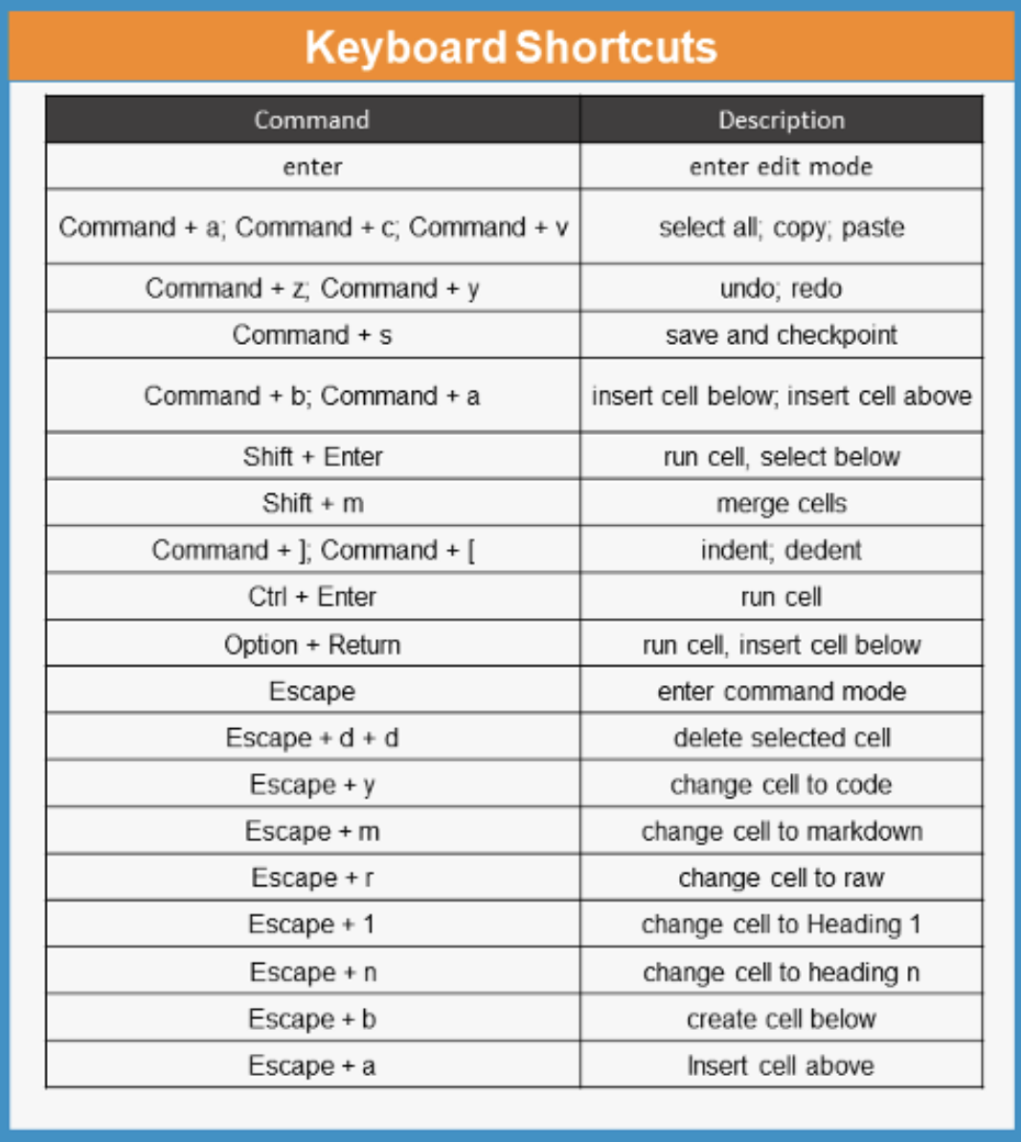
Another small group breakout
Write a function that computes the volume of a sphere or cube.
Practice markdown
https://www.markdownguide.org/cheat-sheet/
Bold, italic, headings, numbered list.
Discuss your favorite keyboard shortcuts (esc+h gives menu)
Discuss report out questions
What can new things can you teach each other about jupyter notebooks?
What is the difference between datahub and running in a local environment?
What are some alternatives to datahub and local environment?
Notes:
Cheat sheet is from https://medium.com/edureka/jupyter-notebook-cheat-sheet-88f60d1aca7

Slide 20
Let’s close out lecture with some renewable electricity generation
The purpose of this exercise is to dip our toes into the waters of manipulating data in jupyter notebooks.
Interested in the original notebook file? It’s here.
Renewables watch archive data are here

